Slide 1

Session 2
Concept and
Requirements
Using NotebookLM to build the first draft of the technical and visual/commercial reports
Specification of Products and Services
Robust Design

Slide 2
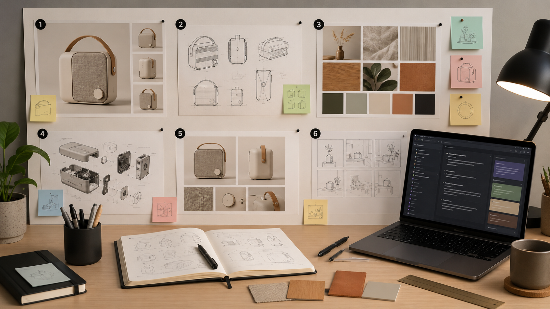
Specification of Products and Services
Today’s goal
Move from the Session 1 index to a usable report section.
Input from Session 1
NotebookLM work
Index of the technical report + idea for the visual/commercial report.
Use uploaded sources to generate a structured draft with text and suggested images.
Output for Session 2
Reports check
Concept and Requirements report: overview, value proposition and requirements.
The report must support both future deliverables: production and user-facing communication.
Session 2 · Concept and Requirements · 02

Slide 3
Specification of Products and Services
What previous reports show us
Good technical reports begin with concept and requirements before moving into production.
Concept
Requirements
Specification
Product idea, user, context, problem and value proposition.
What the product must do, how it should perform and how it will be checked.
Materials, parts, dimensions, drawings, BOM, processes, ergonomics and validation.
Session 2 focuses only on the first two levels.
Do not write the final production manual yet.
Do define what the product needs to prove later.
Do connect technical criteria with how the product will be shown to users.
Concept → Requirements → Evidence
Session 2 · Concept and Requirements · 03

Slide 4
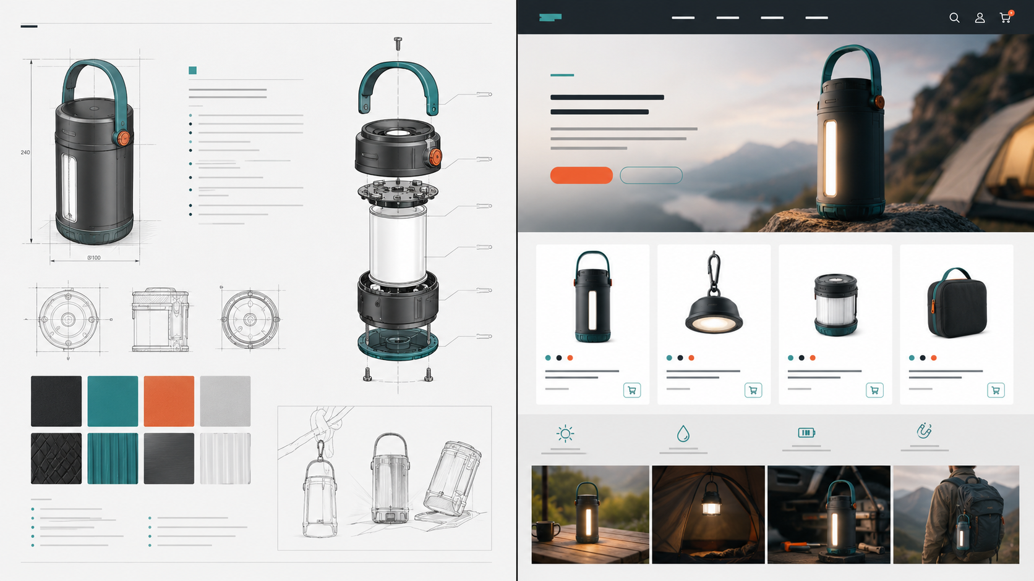
Specification of Products and Services
Two reports, one foundation
The Session 2 report must support both paths.
Technical report
For a manufacturer. It explains what the product is, what it includes, what it must do and what information will be needed for production.
Visual / commercial report
For the final user. It explains how the product should be shown, understood, desired and purchased.
Same product. Different purpose. Different language.
Session 2 · Concept and Requirements · 04

Slide 5
Specification of Products and Services
Session 2 report structure
Can use this as the base for their PDF, Google Doc, Notion page or NotebookLM prompt.
Section
What it must include
1. Overview
What the product is, who it is for and what problem it solves.
2. User + context
Target user, situation of use, needs and pain points.
3. Problem statement
Clear statement of the main problem in 3–5 lines.
4. Value proposition
Why the product is useful, different and desirable.
5. Concept direction
Moodboard, design intention, product personality and key attributes.
6. Technical direction
Materials, parts, mechanisms, dimensions, production, assembly, safety, ergonomics and maintenance.
7. Visual / commercial direction
Website, shopping page, app, configurator, videos, renders, benefits and purchase experience.
8. Requirements table
Requirements with category, criteria, visual translation and evidence needed.
9. MVP + next steps
What the first functional version must prove and what must be researched next.
Session 2 · Concept and Requirements · 05

Slide 6
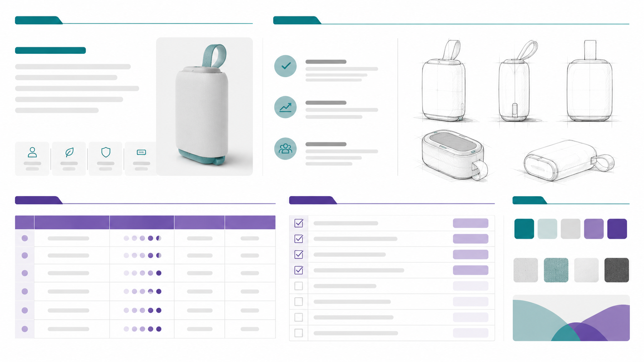
Specification of Products and Services
NotebookLM workflow
NotebookLM can write the first draft, but the team must edit, verify and complete it.
Upload sources
01
Session 1 index, sketches, brief, moodboard, renders, feedback, benchmarks.
Upload visuals
02
Create a visual evidence PDF or slides with numbered images and captions.
Prompt NotebookLM
03
Ask for the Session 2 report using only the uploaded sources.
Edit and layout
04
Move the text and images into Docs, Notion, Canva or PDF format.
Session 2 · Concept and Requirements · 06

Slide 7
Specification of Products and Services
Before prompting: prepare visual evidence
NotebookLM works better when the images are organized and labeled.
Figure
Image type
Caption example
Report section
Fig. 1
Main render or sketch
Product overview and main function
Overview
Fig. 2
User/context image
Where and how the product is used
User + context
Fig. 3
Moodboard
Visual language and product personality
Concept direction
Fig. 4
Parts diagram
Early technical logic of the product
Technical direction
Fig. 5
Website / app mockup
How the product could be shown or sold
Visual / commercial direction
Fig. 6
Prototype photo
What the first MVP should prove
MVP
Tip: do not upload loose images without names. Put them in one visual evidence file.
Session 2 · Concept and Requirements · 07

Slide 8
Specification of Products and Services
Prompt for NotebookLM
Paste this and adapt the project name.
Using only the sources uploaded to this notebook, create a Session 2 report titled “Concept and Requirements”.
Base the report on the index we created in Session 1.
The report must include:
1. Project Overview
2. User and Context
3. Problem Statement
4. Value Proposition
5. Concept Direction
6. Technical Direction for the manufacturer report
7. Visual / Commercial Direction for the user-facing report
8. Requirements Table
9. MVP Definition
10. Missing Information
11. Next Steps
The requirements table must include:
Requirement, Category, Why is it important?, Technical success criteria, Visual / commercial translation, and Evidence needed.
Do not invent information. If something is missing, write “to be defined” or “needs evidence”.
Session 2 · Concept and Requirements · 08

Slide 9
Specification of Products and Services
Requirements table: what each row needs
This is the main evidence of Session 2.
Column
What students should write
Requirement
What the product must do or communicate.
Category
User, functional, technical, ergonomic, production, safety, sustainability or market.
Why it matters
Why this requirement is important for the user, product or context.
Technical success criteria
How it will be checked later: size, weight, time, load, resistance, comfort, etc.
Visual / commercial translation
How this requirement should be shown to the final user.
Evidence needed
What proof must be created: photos, tests, dimensions, diagrams, renders, mockups or references.
Minimum: 12–15 requirements per team
Include user, functional, technical, ergonomic, production, safety, sustainability and market/communication requirements.
Session 2 · Concept and Requirements · 09

Slide 10
Specification of Products and Services
Report checklist
Section | What it should include | Checklist
1. Cover / Header | Project name, team members, course name, session number and date. | Project name. Team members. Course name. Session 2. Date. Main image, sketch or render.
2. Project Overview | A short explanation of what the product is. | What the product is. Who it is for. What problem it solves. Where or when it is used.
3. User and Context | Description of the main user and use situation. | Target user. Approximate age or profile. User activities. Use context. Main user needs.
4. Problem Statement | Clear explanation of the main problem. | Clear problem. Current situation. Why the problem matters. Main difficulty or friction.
5. Value Proposition | Explanation of why the product is valuable, different and desirable. | Main benefit. Difference from existing products. Why the user would use it. Why the user would buy it.
6. Concept Direction | Design intention, visual references and product personality. | Main concept idea. Moodboard or references. Initial color palette. Product attributes. Visual tone.
7. Technical Direction | Direction for the future manufacturer report. | Possible materials. Main parts. Mechanisms or connections. Dimensions to define. Possible production processes. Assembly logic. Maintenance. Safety considerations.
8. Visual / Commercial Direction | Direction for the future user-facing report. | Type of visual deliverable: website, landing page, shopping page, app or configurator. Images needed. Main benefits to communicate. How product use will be explained. How purchase or customization will be shown.
9. Requirements Table | Main table of product requirements. | User requirements. Functional requirements. Technical requirements. Ergonomic requirements. Production requirements. Safety requirements. Sustainability requirements. Market / communication requirements.
10. Success Criteria | How each requirement will be checked. | Each requirement has a way to be verified. Includes measurable or observable criteria such as size, weight, resistance, comfort, time, ease of use or expected test.
11. Evidence Needed | Evidence that will be created in later sessions. | Photos. Sketches. Renders. Diagrams. Tests. Measurements. Material references. Benchmarks. User feedback.
12. MVP Definition | What the first functional version must include. | Main function. What the MVP includes. What the MVP does not include yet. What will be tested first.
13. Missing Information | Information the team still needs to find, define or test. | Missing dimensions. Materials to confirm. Processes to research. Costs to estimate. Tests to design. Missing images or diagrams.
14. Next Steps | Concrete actions before the next session. | 5 to 7 clear actions. What to research. What to draw. What to measure. What to test. What image, render or diagram to prepare.
Session 2 · Concept and Requirements · 07

Slide 11
Specification of Products and Services
Example: one requirement row
Use this level of clarity; avoid vague words like “nice”, “cool” or “resistant” without proof.
Requirement
Category
Why it matters
Success criteria
Visual translation
Evidence
The product must remain stable during movement.
Technical / user
The user will move while carrying, wearing or attaching the product.
It does not detach, block movement or move excessively during a basic movement test.
Show the product in real use: walking, skating, biking, commuting or outdoor activity.
Video test, photos, feedback.
Weak requirement
Better requirement
Best next step
“The product should be resistant.”
“The module must resist X weight or X movement test without detaching.”
Define what X is and what evidence will prove it.
Session 2 · Concept and Requirements · 10

Slide 12
Specification of Products and Services
What images should support the report?
Each image should prove or explain something. Do not use images only as decoration.
Product image
Best render, sketch or prototype photo for the overview.
User context
Photo, collage or scenario showing where the product is used.
Concept direction
Moodboard, material references, color palette and design attributes.
Technical direction
Parts sketch, exploded view, mechanism diagram or material references.
Visual report
Website, shopping page, app or configurator mockup.
Label images as Figure 1, Figure 2, etc. and write a short caption.
Session 2 · Concept and Requirements · 11

Slide 13
Specification of Products and Services
Session 2 submission checklist
The report must show direction, criteria and evidence plan — not final production content yet.
Overview: clear in 3–5 lines.
User and context: specific, not generic.
Value proposition: useful + different + desirable.
Technical direction: what the manufacturer report will need later.
Visual/commercial direction: how the user will understand and want the product.
Requirements table: 12–15 rows with success criteria and evidence needed.
MVP: what the first version must prove.
Missing information + next steps: honest and specific.
The Session 2 report must have 8 to 12 pages, including text, tables and visual references. The report should not exceed 15 pages.
Final output
Concept and Requirements Report
PDF / Notion / Google Doc / Canva
Use NotebookLM, but edit your final text
Session 2 · Concept and Requirements · 12

